Slide 1
Social Media Data Analytics

Slide 2
Module 1 – Networks
1

Slide 3
Module 1: Networks – Background
What does it do?
Produces an Excel list of 100 most-frequently-followed Twitter accounts based on an initial group of 5 accounts selected by the user
What is it useful for?
Useful for identifying new academics, opinion-leaders or popular Twitter accounts to follow in order to keep up-to-date on a specific theme
How does it work
The user inputs 5 initial Twitter accounts (selected for their centrality in a field by the user’s familiarity with the topic). The Tool selects the 19 accounts jointly most followed by these users; then is selects the 19 jointly most followed by those users… And so on for 5 iterations. Why 19? Because 5 initial accounts + 5 iterations * 19 accounts per iteration = 100 total accounts

Slide 4
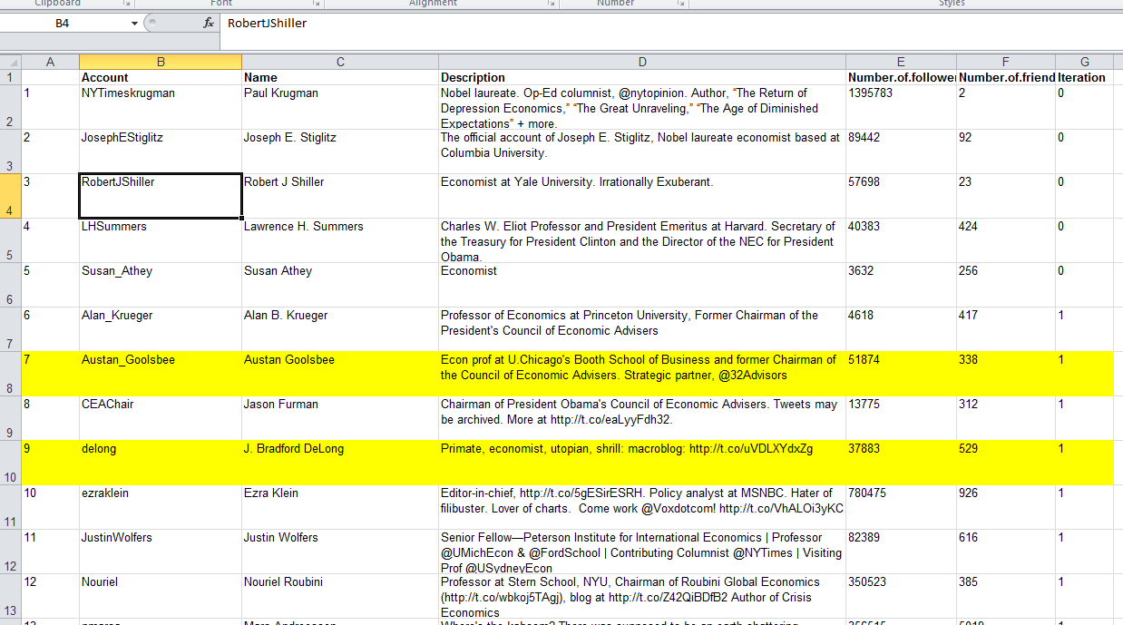
Module 1: Networks – Economics Example
Input | Output
We input 5 top macro-economists: Paul Krugman Joseph Stiglitz Robert Shiller Larry Summers Susan Athey | We get a list of 100 top economists (with some journalists or publications). We can use this to identify new individuals to engage.
The initial list input by the user
Interesting insights – economists that we were not aware of before

Slide 5
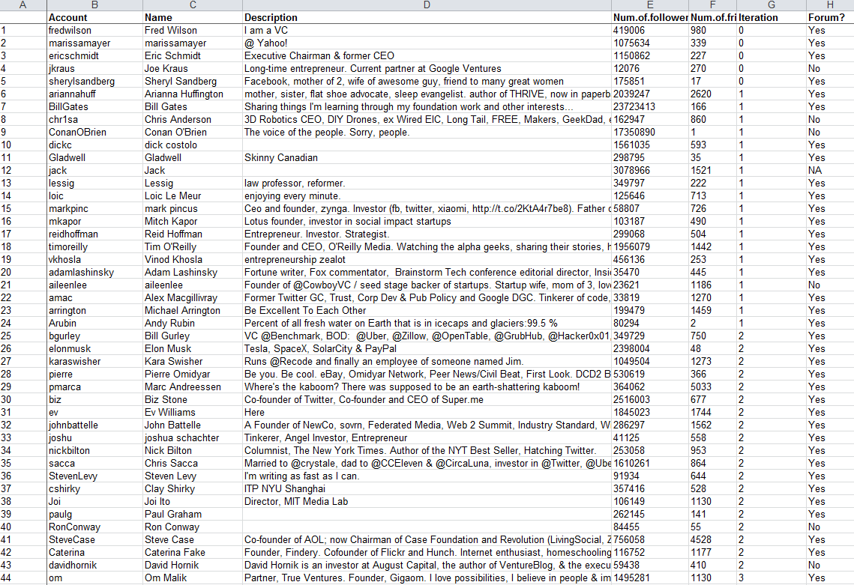
Module 1: Networks – Technology Example
Input | Output
We input 5 top technologists: Fred Wilson Marissa Mayer Eric Schmidt Joe Kraus Sheryl Sandberg | We get a list of 100 top technology influencers. We can review this list to uncover new influential accounts, people or organizations that could be relevant to technology coverage.
The initial list input by the user

Slide 6
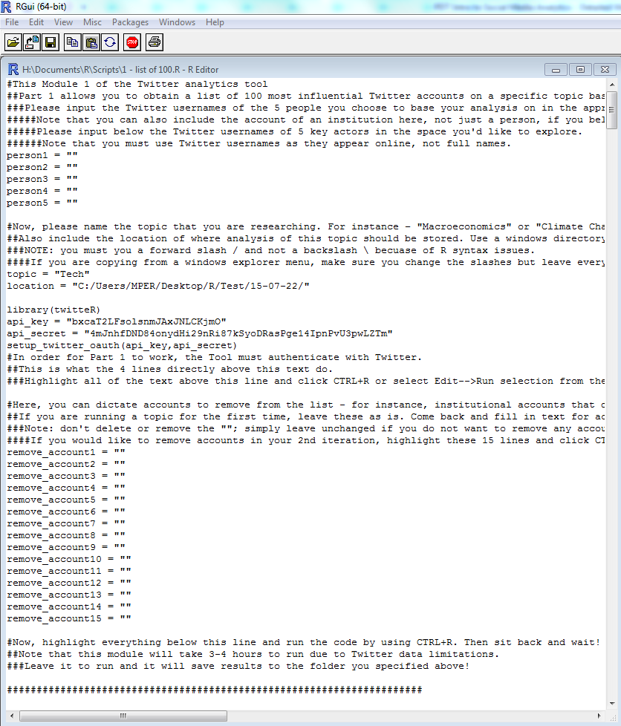
Module 1: Networks – Tool Interface in R
The user types in the list of 5 people
The user inputs a directory (where the Excel file will be saved) and a topic (that the Tool uses to name the Excel file produced)
After producing a network for the first time, the user can go back and eliminate certain accounts – for instance institutional accounts of a news publication or company – and re-run Module 1. This can help “sanitize” the list and make sure it focuses on individuals instead of companies or organizations

Slide 7
Module 2a – Hashtags
2a

Slide 8
Module 2a: Hashtags – Background
What does it do?
Based on Tweets of the list of 100 accounts from Module 1, creates a heatmap and a wordcloud of top hashtags for specific timeframes specified by the user
What is it useful for?
Useful for identifying new or big ideas among a community of key influencers in a specific topic
How does it work
The Tool parses the Tweets’ text and separates hashtags. It then creates a frequency table and uses it to build the wordcloud and the heatmap, based on a date range provided by the user

Slide 9
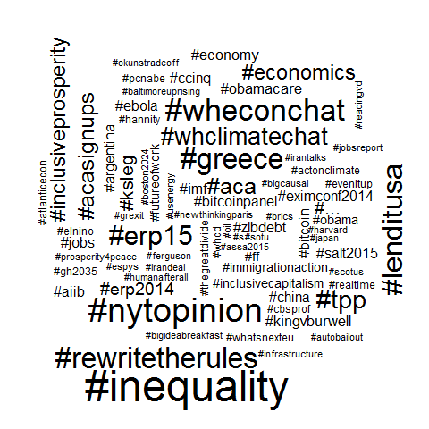
Module 2a: Hashtags – Economics Example
Input | Output
After pulling the Tweets of the macroeconomics list (from Module 1), we input a date range (1.2.2015 – 15.7.2015 in this example) | We get a wordcloud reflecting top hashtags in this network. Some interesting insights: Inequality is top of mind for this network Inclusive Prosperity is a popular term (seen here for first time) Rewrite the Rules (a Joseph Stiglitz book) is extremely popular – potentially worth moving to top of reading list

Slide 10
Module 2a: Hashtags – Technology Example
Input | Output
After pulling the Tweets of the technology list (from Module 1), we input a date range (1.1.2014 – 31.1.2014 in this example) | We get a heatmap reflecting top hashtags during this time. The heatmap shows activity about several conferences and events happening at this time – indicating the concentration of the same crowd in multiple events
Most popular hashtags reflect several conferences and events throughout the period

Slide 11
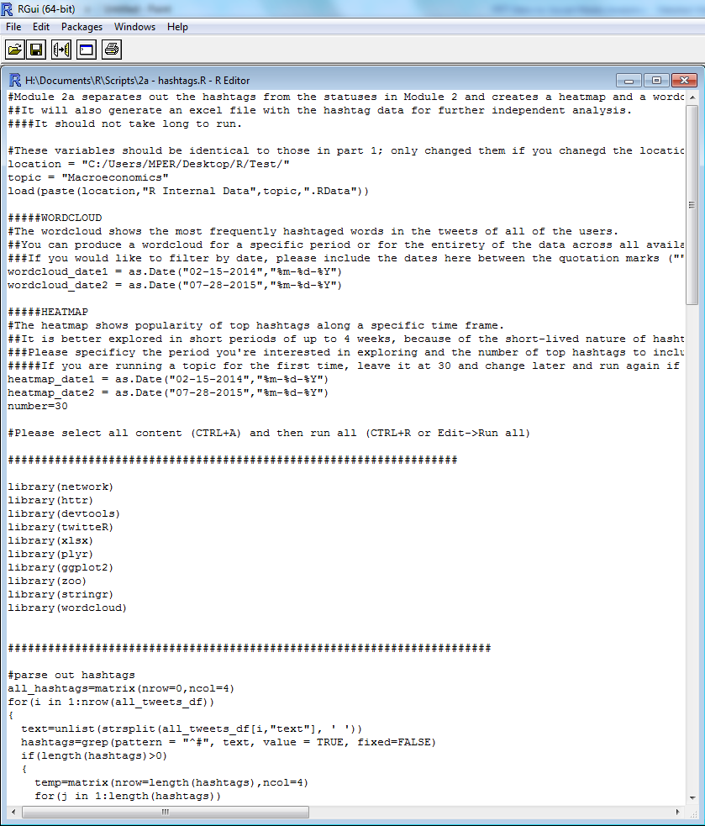
Module 2a: Hashtags – Tool Interface
The user types in the same directory and topic definition from Module 1
The user types in the date range they would like to explore – one for the wordcloud and one of the heatmap (they can be identical or different, depending on the user’s research objectives)

Slide 12
Module 2b – Tags/Mentions
2b

Slide 13
Module 2b: Tags – Background
What does it do?
Based on Tweets of the list of 100 accounts from Module 1, creates a barchart of the most-frequently-tagged accounts (reflecting popularity within the network)
What is it useful for?
Useful for identifying popular individuals or accounts whose opinions are widely echoed and whom it could be valuable to follow
How does it work
Twitter uses the @ symbol to mention, or tag, another user in a Tweet. The Tool parses the text of Tweets and separates tags. It then creates a frequency table of the most mentioned accounts across all statuses and uses it to build a bar chart of the most mentioned accounts.

Slide 14
Module 2b: Tags – Technology Example
Input | Output
We select the number of top accounts to display in the bar chart. The default is 20 but can be changed by the user | We get a barchart of the top 20 most tagged accounts. An interesting insight from it: The second results is Liz Gannes, a writer for ReCode who is not well-known otherwise. Given her popularity within the network, she could be an important source to consider following for news/industry updates
Liz Gannes is the 2nd most tagged account, behind only Marc Andreessen (pmarca)

Slide 15
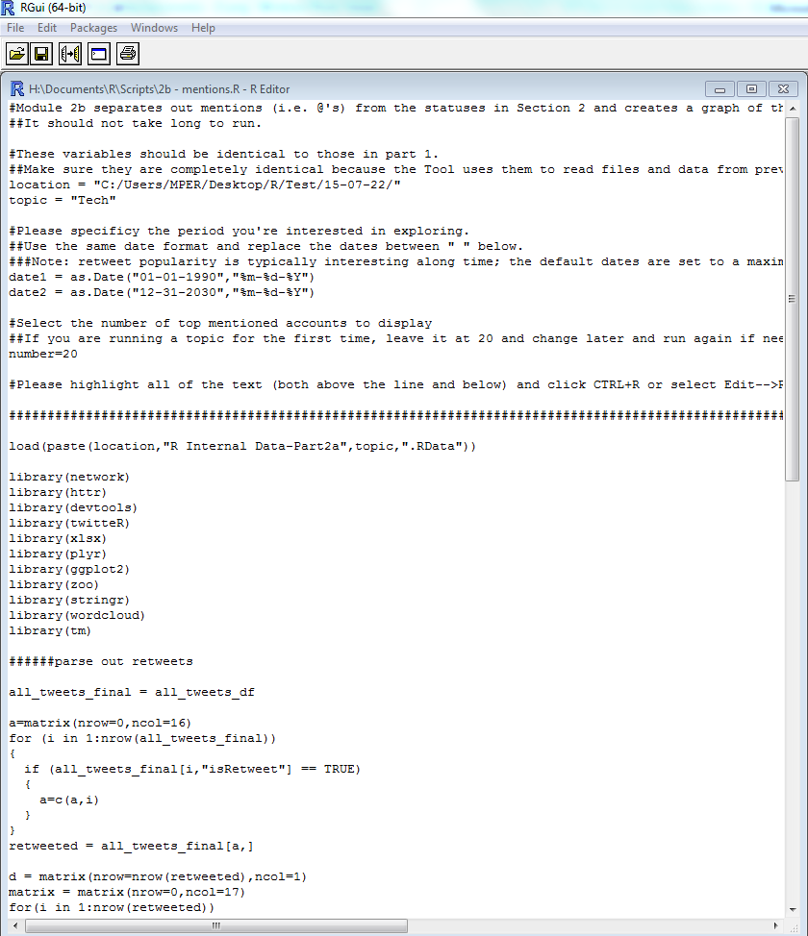
Module 2b: Tags – Tool Interface
The user types in the same directory and topic definition from Module 1
The user inputs the number of top accounts to display in the barchart. The default is set to 20, which is a good number to obtain coverage without cluttering the chart, but can be changed by the user

Slide 16
Module 2c – Links
2c

Slide 17
Module 2c: Links – Background
What does it do?
Based on Tweets of the list of 100 accounts from Module 1, creates an Excel file with the most frequently shared URLs
What is it useful for?
Useful for identifying important news sources within a topic area to help prioritize research or reading
How does it work
The Tool separates text that resembles a URL (words starting with “http..”) and uses a special function to find the full website address from the Twitter shortcuts (which appear as https://t.co/I82Kx5UHuv). It then creates an Excel file with a frequency table of the most widely shared addresses

Slide 18
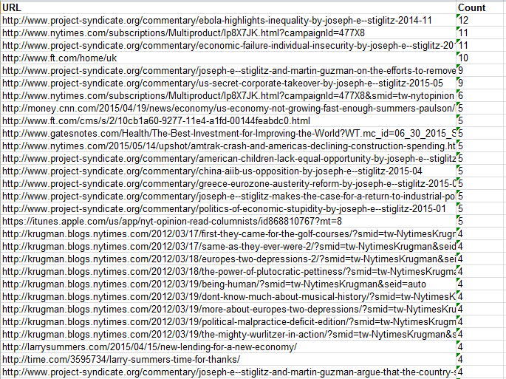
Module 2c: Links – Economics Example
Input | Output
After pulling the Tweets of the list of economists (from Module 1), we select a subset of users 1-10* | We get an Excel with URLs shared by this subset of users, ordered by the most frequently shared ones. This helps in noticing articles that were very popular in the network (for instance Joseph Stiglitz’s recent publications).
Joseph Stiglitz Project Syndicate commentary is popular among these users
* We select a subset and cannot get links for all 100 accounts because of processing times. Since there are hundreds of thousands of Tweets, and most tend to contain links, it would take 12+ hours to obtain the URLs for the full list. We therefore must restrict to the Tweets of a subset of uesrs so that the Tool runs more quickly.

Slide 19
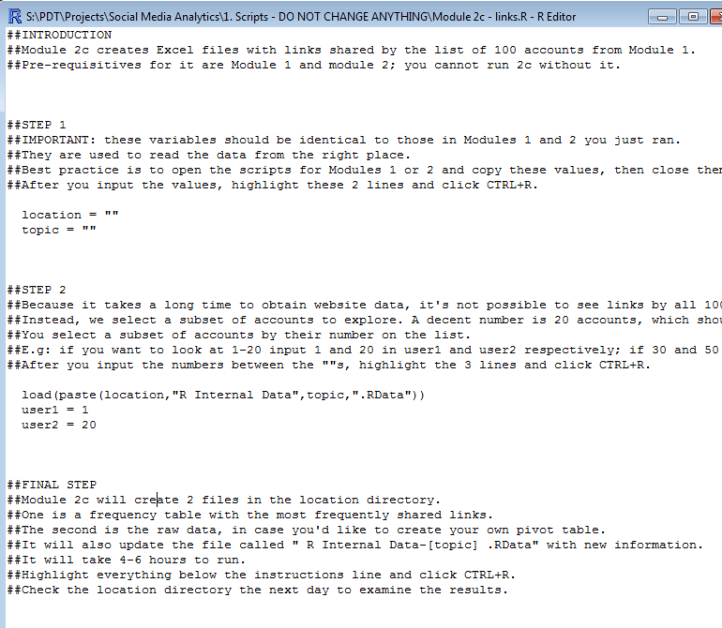
Module 2c: Links – Tool Interface
The user types in the same directory and topic definition from Module 1
The user inputs the number of accounts to include in the analysis; because of timing limitations, not all 100 accounts can be analyzed at the same time

Slide 20
Module 3 – Shortlists
3

Slide 21
Module 3: Shortlists – Background
What does it do?
Create the same outputs (wordcloud, barchart, links Excel) using the Tweets of a shortlist of 1-20 accounts selected by the user (instead of the list of 100 accounts from Module 1)
What is it useful for?
Useful for identifying insights about a specific group of stakeholders
How does it work
Module 3 uses the same methods as in previous Modules but bases outputs on the Tweets of the shortlist provided by the user instead of on the Tweets of the list of 100 accounts from Module 1

Slide 22
Module 3: Links – Clean Energy Example
Input | Output
We input 5 initial users: A wind energy company A solar energy company A nuclear energy company An oil&gas CEO A sustainability NGO | We get a wordcloud showing the diversity of themes but can also notice common topics: The Export-Import Bank STEM We also get a barchart of frequently tagged accounts: State of the Gulf (BP’s account for oil spill updates) is widely mentioned and is attracting significant attention

Slide 23
Module 3: Links – Conservative vs. Liberal Economists Example
Input | Output
We input 5 initial users: 2 conservative economists 2 liberal economists 1 centric economist | We get a wordcloud showing many branded hashtags (those promoting a specific show/blog/ publication) but also thematic ones like inequality and ObamaCare

Slide 24
Module 3: Links – Climate
Input | Output
We input 5 initial users with links to climate topics: The UNFCCC 3 environmental NGOs 1 oil&gas CEO | We get a wordcloud showing important environmental themes. In addition to general climate calls-for-action and mentions of negotiations, we see: SB42 - a U.S. car/smog bill Children’s health

Slide 25
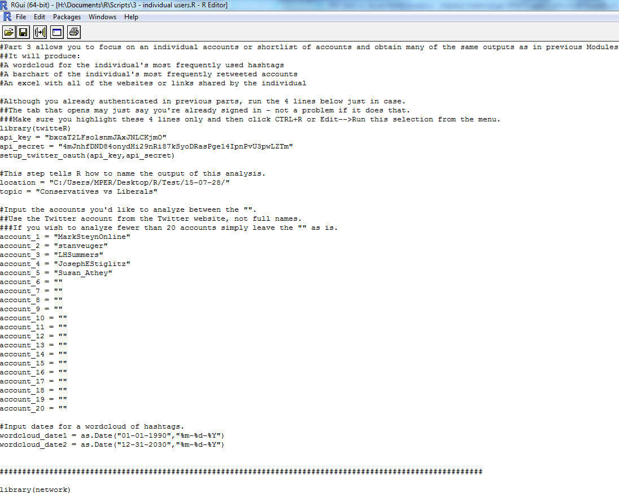
Module 3: Shortlists – Tool Interface
The user inputs the directory in which to save the outputs and the topic to use in naming the output files
The user inputs the Twitter accounts to investigate
The user can input a date range for the wordcloud, if wanted

